Slide 1
Pure Substances and Mixtures
Unit 2

Slide 2
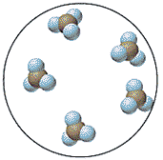
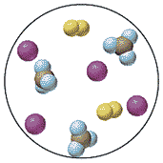
Matter
can be divided into two categories
Pure Substances
Mixtures
Different types of particles are mixed together.
All the particles are the same.

Slide 3
Pure Substances
Consist of:
Elements
Compounds
What
differences
do you see?

Slide 4
Pure Substances
Element: Basic unit of substances which are made up of only ONE type of atom
Examples:
Carbon (C) Gold (Ag)
Oxygen (O) Helium (He)
The entire periodic table of ELEMENTS

Slide 5
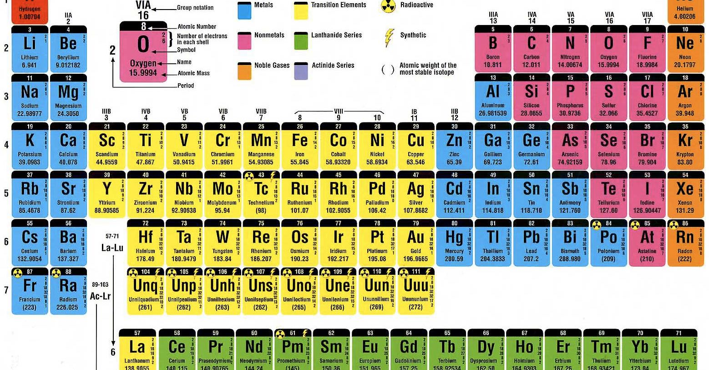
All elements (the different types of atoms) are listed on
the Periodic Table.

Slide 6
Pure Substances
Compound: TWO or more elements chemically combined [BONDED]
Examples:
Ammonia, salt, sugar, and formulas such as:
NaCl CO2 H2O NaHCO3

Slide 7
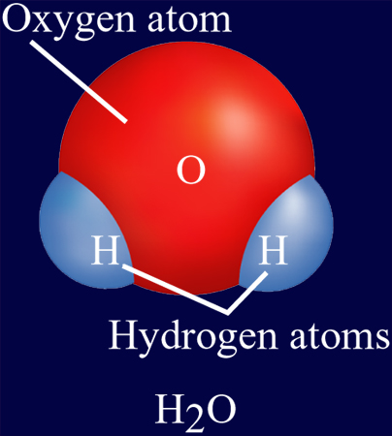
How to read a formula:
H₂0
This is a subscript. It tells us how many atoms of that element exist in one unit of that compound.
Hydrogen is made of 2 H atoms and 1 O atom.
No subscript is used when only one atom of an element is present.

Slide 8
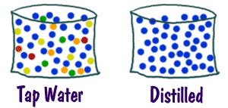
Mixtures
A mixture is a combination of two or more substances where there is NO chemical combination or reaction.

Slide 9
Mixtures are either
Homogeneous
Heterogeneous
?
?
I’m going to give you the definitions and let’s see if you can create the pictures!

Slide 10
Homogeneous Mixture
The prefix: "homo"- indicates the same
Have a uniform appearance and composition throughout

Slide 11
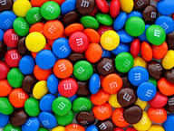


Homogeneous Mixture
Examples:
  Vinegar
  Perfume/Cologne
  Honey
  Jell-O (Colloids)
  Mouthwash
  Vegetable Oil
  Coffee
  Water
  Blood

Slide 12
Mixtures
Homogeneous Mixture
Solution

Slide 13
Solution
A Solution is a mixture of two or more substances.
Solute: The substance that is being dissolved – the smallest amount of the two
Solvent: The substance that is doing the dissolving – the larger amount of the two. Water is our universal solvent.
Question: Kool-Aid and water – Which is the solvent? Which is the solute?

Slide 14
Heterogeneous Mixture
The prefix: "hetero"- means different
A heterogeneous mixture consists of visibly different substances or phases
Two or more parts can be seen

Slide 15
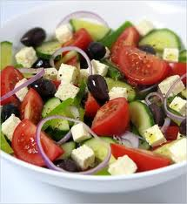
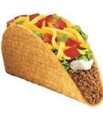
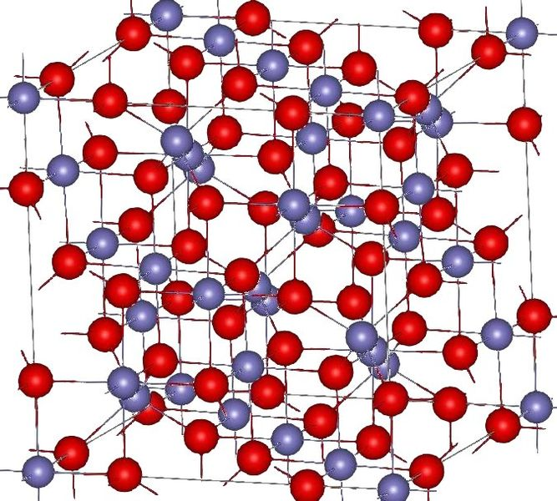
Heterogeneous Mixture
Examples:
  Lucky Charms
  Captain Crunch
  Granite/Marble
  Chocolate Chip Cookies
  Sand in water
  Muddy Water
  (Suspensions)

Slide 16
Mixtures are either
Homogeneous
Heterogeneous
Remember this?? What do your pictures look like?!

Slide 17
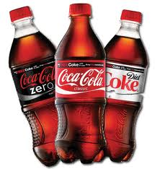
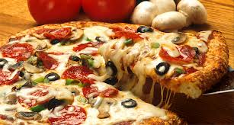
Mixtures
can be divided into two categories
Homogenous
Heterogeneous
The different parts are not visible.
The different parts are visible and can be separated mechanically.

Slide 18
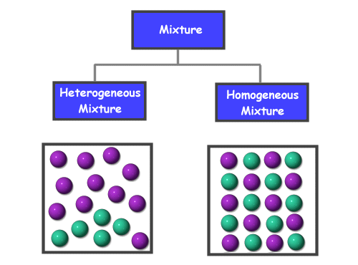
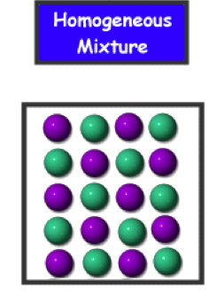
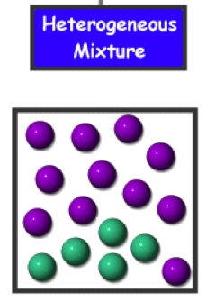

Slide 19
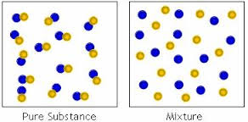
Pure Substance or Mixture?

Slide 20
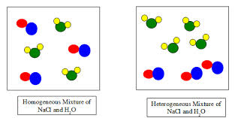
What type of mixture?
A B

Slide 21
So to review:
Fill in the squares with drawings of element/compound/mixture:
Element
Homogeneous
Solution
Heterogeneous
Your Choice
Mixture
Compound

Slide 22
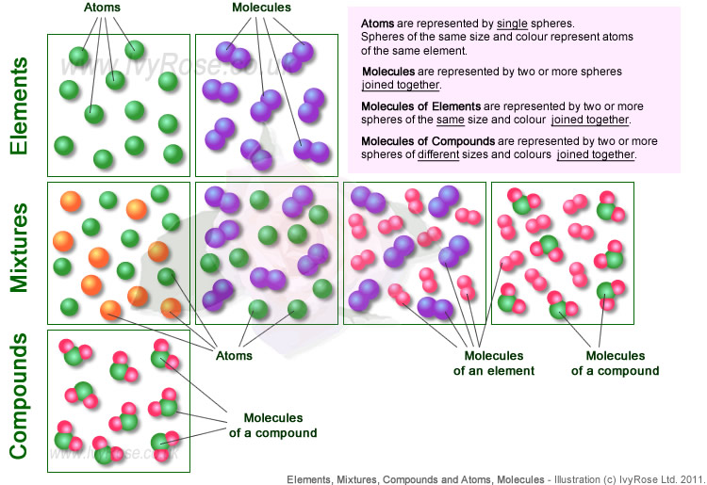

Slide 23
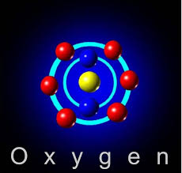
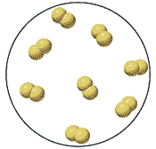
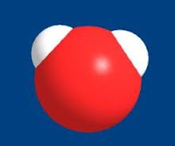
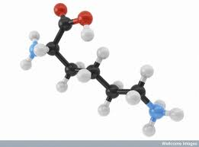
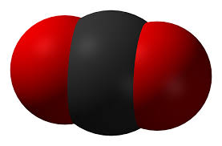
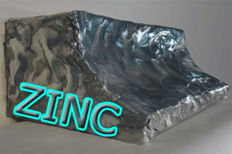
Some More Reviewing:
Which is which?

Slide 24
Material | Pure Substance or Mixture | Element, Compound, Homogeneous, Heterogeneous
Limestone (CaCO₃) | PURE SUBSTANCE | COMPOUND
Air | MIXTURE | HOMOGENEOUS
Bronze | MIXTURE | HOMOGENEOUS
Copper | PURE SUBSTANCE | ELEMENT
Sugar + water | MIXTURE | HOMOGENEOUS
Concrete | MIXTURE | HETEROGENEOUS
Pure Water | PURE SUBSTANCE | COMPOUND
Caffeine | PURE SUBSTANCE | COMPOUND

Slide 25
