Slide 1
Energy Review

Slide 2
1. Name the form of energy:
This energy is from the kinetic energy (random motion) of an object’s particles

Slide 3
2. Name the form of energy:
You add the potential and kinetic energy to get this type of energy

Slide 4
3. Name the form of energy:
This energy is in the center of an atom (the nucleus)

Slide 5
4. Name the form of energy:
This energy is between the bonds of atoms

Slide 6
5. Name the form of energy:
This energy is from the vibrations of electromagnetic particles
*use the scientific name! [not light]

Slide 7
6. Name the form of energy:
This energy is from the vibrations of particles in a medium

Slide 8
7. Name the form of energy:
This energy is from moving electrons

Slide 9
8. Name the form of energy:
These two energies are both types of vibrations

Slide 10
9. Name the form of energy:
This is the type of energy due to motion

Slide 11
10. Name the form of energy:
This is the type of energy due to position (stored energy)

Slide 12
11. Name the form of energy:
This energy is the only energy that is both kinetic and potential

Slide 13
12. Name the form of energy:
These two energies are forms of potential energy

Slide 14
13. Name the form of energy:
These four energies are forms of kinetic energy

Slide 15
14. Name the law:
This law states that energy cannot be created or destroyed, it can only be transformed

Slide 16
15. Name the transformation of energy:
Inside of the sun → Light & Heat

Slide 17
16. Name the transformation of energy:
Batteries → Wires → Bulb

Slide 18
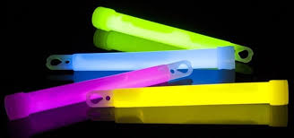
17. Name the transformation of energy:
Inside of the glow stick → Light

Slide 19
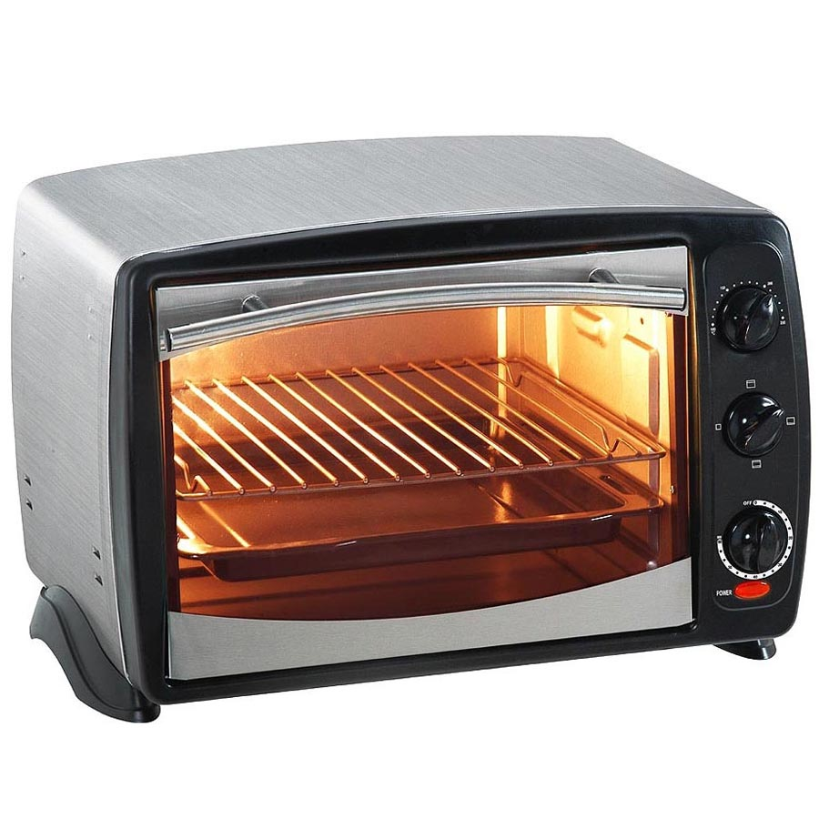
18. Name the transformation of energy:
Wires → Heat & Light

Slide 20
19. Name the transformation of energy:
→

Slide 21
20. Name the transformation of energy:

Slide 22
21. Name the transformation of energy:

Slide 23
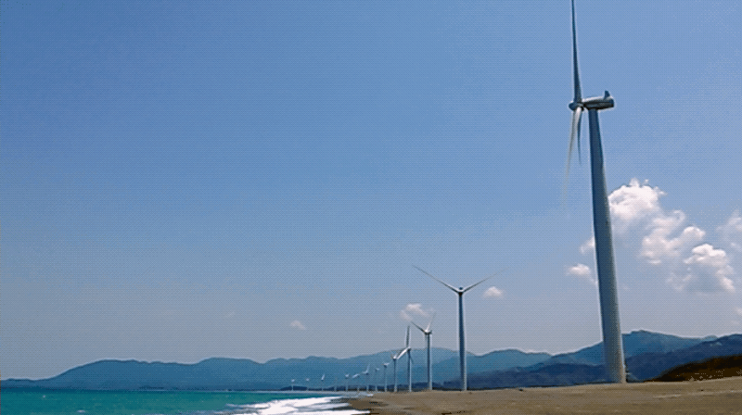
22. Name the transformation of energy:
Wind & Turbines → Wires

Slide 24
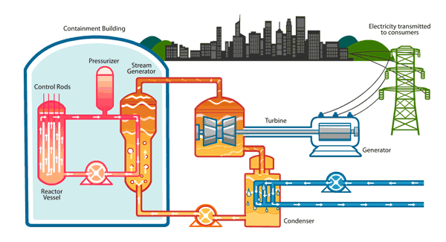
23. Name the transformation of energy:
Nuclear Fission →
Heat →
Turbines moving →
Wires →
Lights

Slide 25
24. Name the transformation of energy:
Sun →Light →Photosynthesis

Slide 26
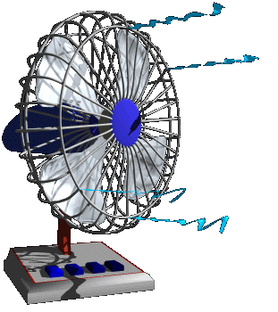
25. Name the transformation of energy:
Wires → Fan blades

Slide 27
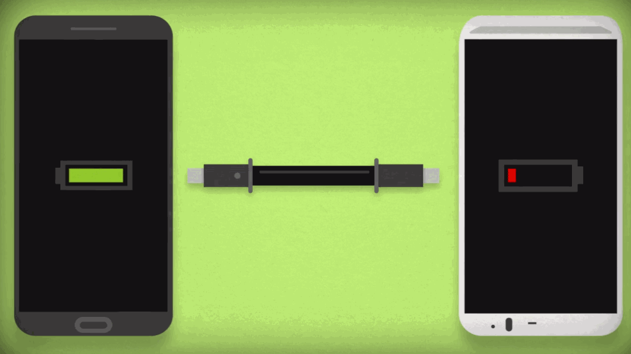
26. Name the transformation of energy:
Battery 1 → Wires → Battery 2

Slide 28
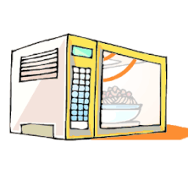
27. Name the transformation of energy:

Slide 29
28. Find the picture that matches the energy transformation
Nuclear → Radiant & Thermal → Chemical → Chemical → Mechanical → Thermal
Notes:
Rubbing hands together

Slide 30
29. Find the picture that matches the energy transformation
Nuclear → Radiant & Thermal → Mechanical → Electrical → Sound
Notes:
Radio with wind turbines

Slide 31
30. Find the picture that matches the energy transformation
Nuclear → Radiant & Thermal → Mechanical → Electrical → Thermal → Chemical
Notes:
Cooking dinner

