Slide 1
Temperature and Heat Transfers

Slide 2
Thermal Energy is…
TOTAL kinetic energy of the particles in an object.
Low kinetic energy
High kinetic energy
Longer arrows mean more energy

Slide 3
Thermal Energy
The bigger an object is, the more thermal energy it has because it has more particles!
Ex: A glacier would have more thermal energy than a cup of coffee because the glacier is BIGGER.
Tiny cup of coffee
Giant glacier

Slide 4
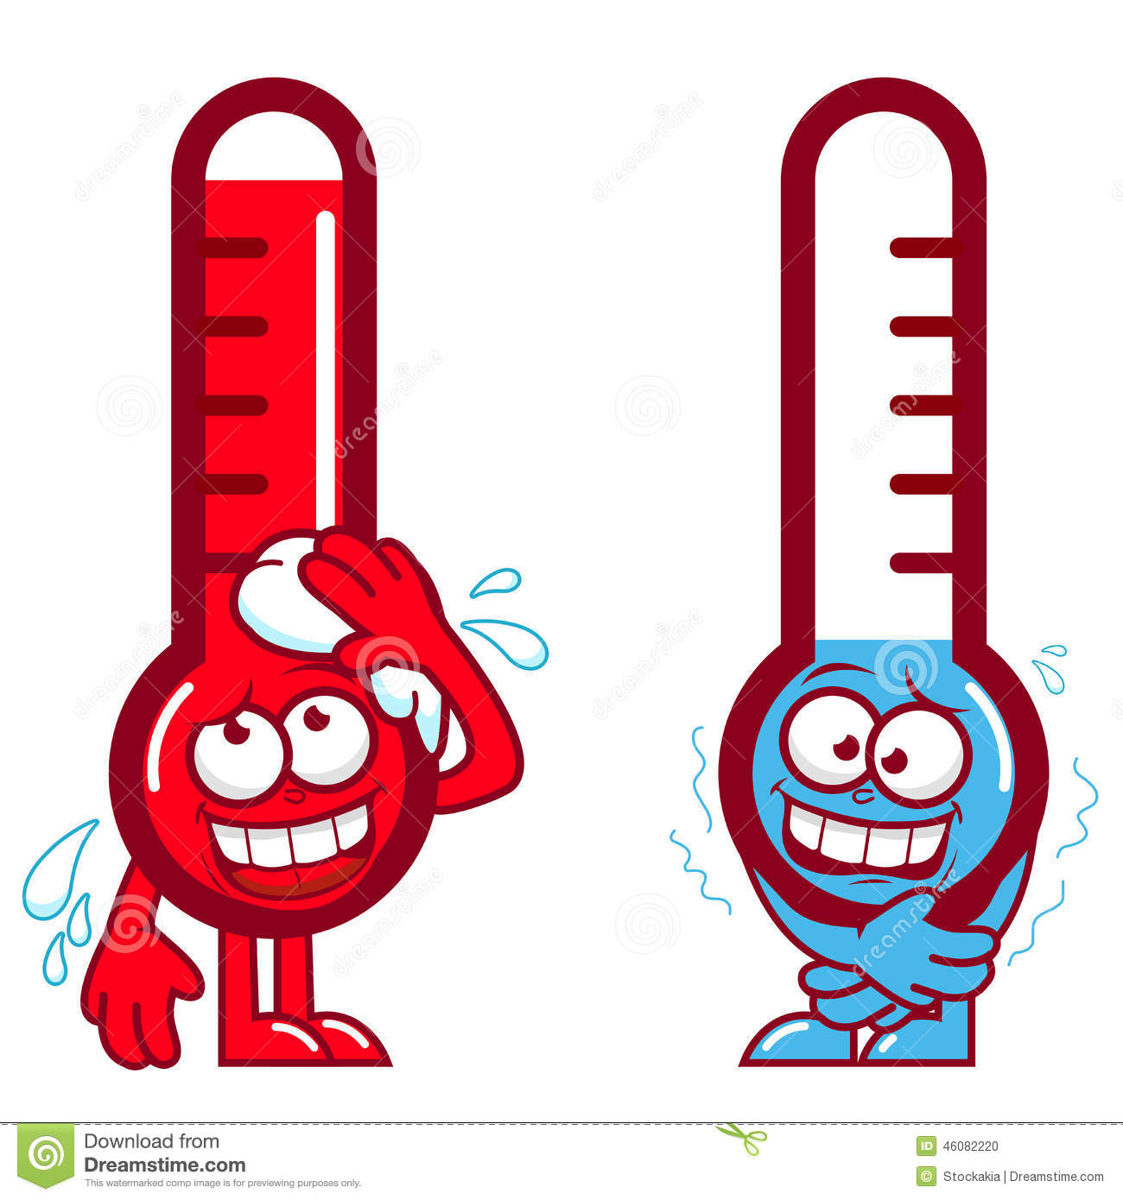
Temperature is…
AVERAGE kinetic energy of the particles in an object.
High kinetic energy
Low kinetic energy

Slide 5
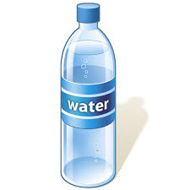
Temperature
Two objects of different sizes could have the same temperature because it is the average of all the particles!
78˚ F
78˚ F

Slide 6
Question…
AVERAGE kinetic energy of the particles in an object.
High kinetic energy
Low kinetic energy

Slide 7
111˚ F
101˚ F

Slide 8
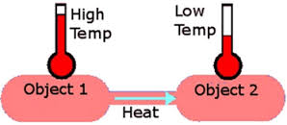
Heat moves
From the hotter object to the cooler object..

Slide 9
Heat Transfers
Hot objects in a cooler room will cool to room temperature.
Cold objects in a warmer room will heat up to room temperature.

Slide 10
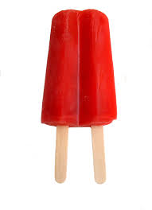
Think About It:
If a cup of coffee and a red popsicle were left on the table in this room what would happen to them? Why?

Slide 11
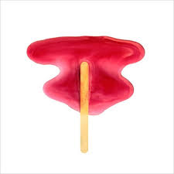
Think About It:
The cup of coffee will cool until it reaches room temperature. The popsicle will melt and then the liquid will warm to room temperature. Everything wants to be at EQUILIBRIUM.

Slide 12
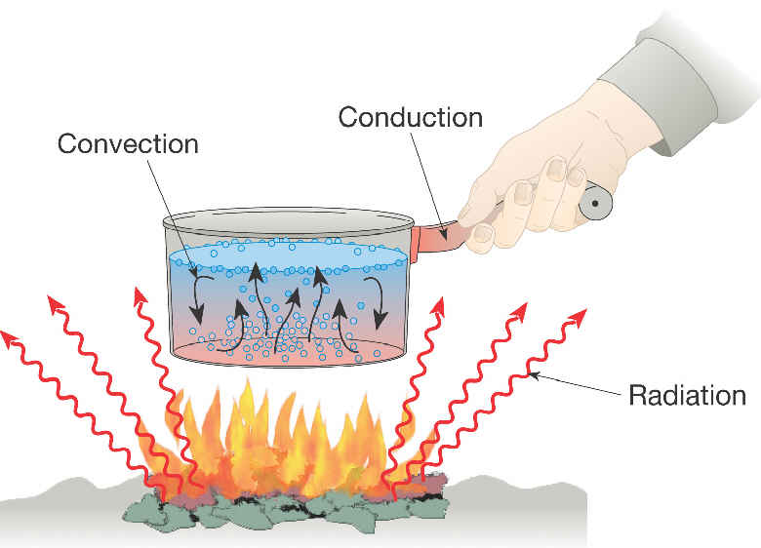
Heat Transfers
A heat transfer is when heat is passed from one object to another through conduction, convection, or radiation.

Slide 13
Conduction
The transfer of heat through direct contact.
This typically happens in solids because the atoms in an object vibrate together (collide), spreading the thermal energy.

Slide 14
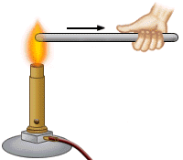
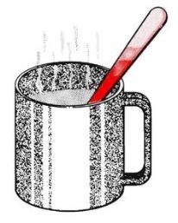
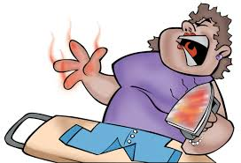
Examples of Conduction
The particles in the metal rod vibrate and transfer the heat to the hand through direct contact
The particles in the metal spoon are vibrated from being in contact with the hot tea
The eggs are cooked because they are in direct contact with the hot pan.
The clothes are ironed because they are in direct contact with the iron. She burns her hand because she touched the hot iron

Slide 16
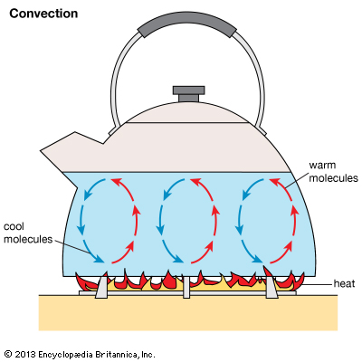
Convection
The transfer of heat through fluids (liquids and gases) using currents.
This is the only heat
transfer where the
particles move!

Slide 17
Currents
What is a current? A current is produced when hot fluids (gases or liquids) rise and cool fluids sink. This happens because cool fluids are more dense.
Think of how a solid is more dense than a gas.

Slide 18
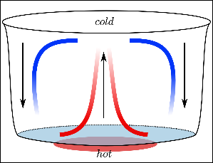
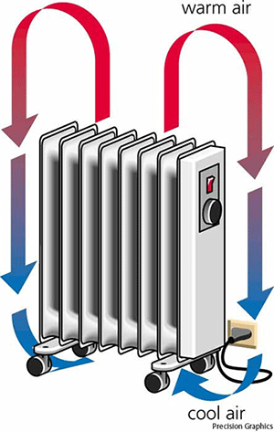
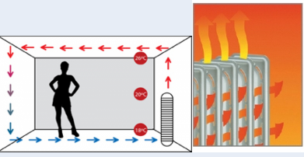
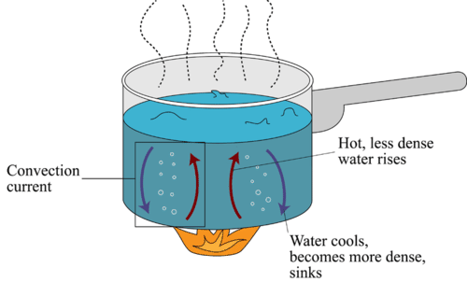
Examples of Convection

Slide 20
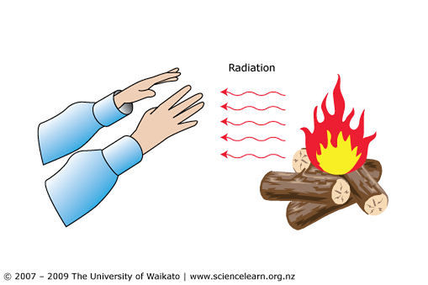
Radiation
The transfer of heat through electromagnetic waves. Specifically for heat, infrared waves

Slide 21
Radiation
What is an electromagnetic wave? Waves that can travel through space, such as light waves, radio waves, infrared, microwaves, UV waves.

Slide 22
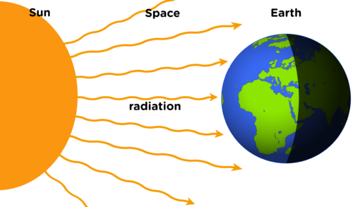
Examples of Radiation

