Slide 2
Warm-Up Feb. 5, 2014
Look in your notes:
1. What is the difference between kinetic and potential energy?
2. What is the equation for kinetic energy?
3. You serve a volleyball with a mass of 5 kg. The ball leaves your hand with a speed of 30 m/s. What is it’s KE?

Slide 3
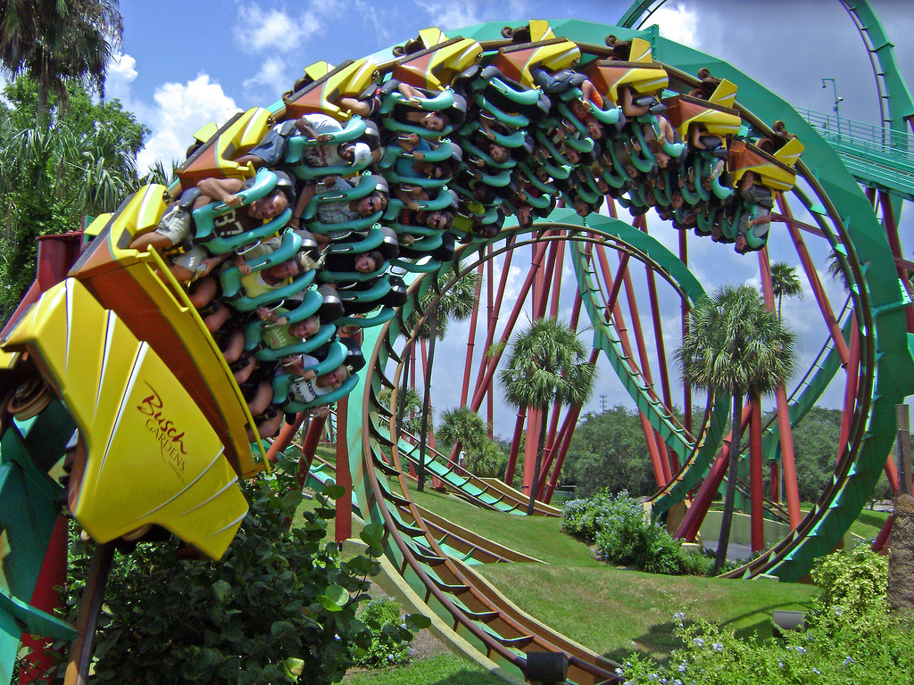
Warm-Up February 5, 2014
Write the question and answer in your notebook
1. How is a roller coaster an example of energy???
2. What does the word potential mean?

Slide 4
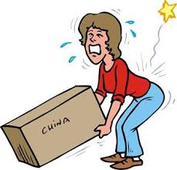
Energy
Energy: the ability to do work
Work: measure of force applied over a distance to move an object
Rally Robin:
What do we need energy for?

Slide 5
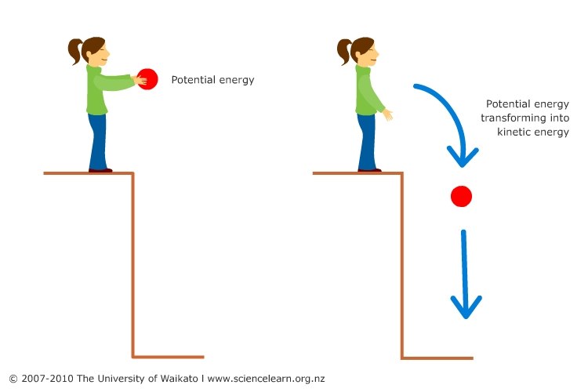
Two Kinds of Energy
Potential Energy: energy an object has stored, or because of position
Kinetic Energy: the energy an object has because of its motion

Slide 6
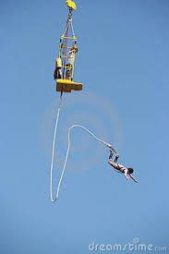
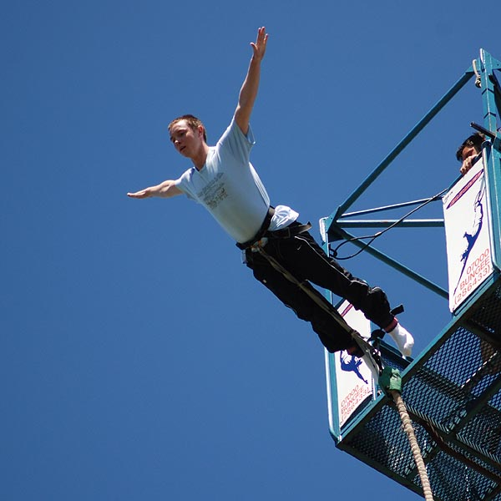

Slide 7
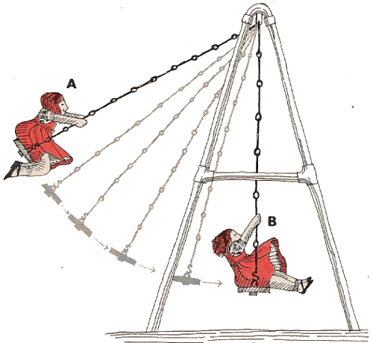

Slide 8
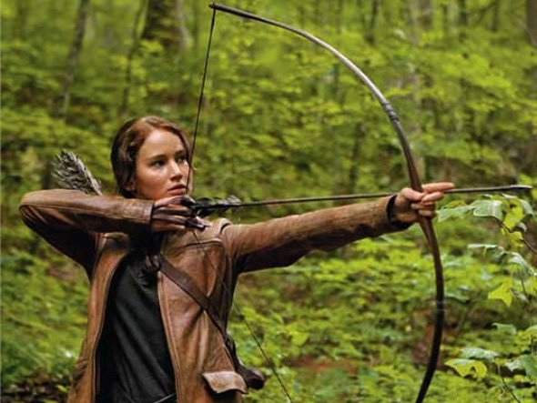
Examples!!!

Slide 9
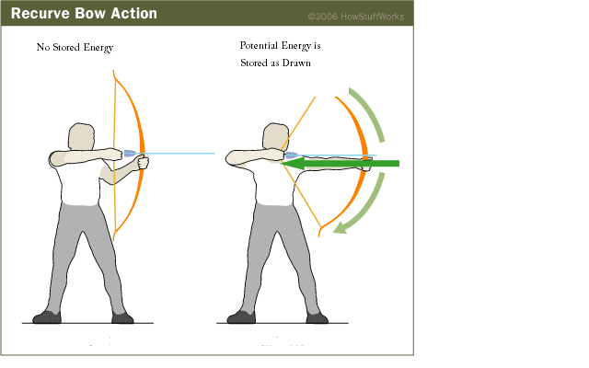

Slide 10
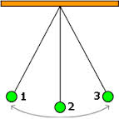
Where is the kinetic energy and potential energy?

Slide 11
1st-3rd
Brain pop video on Potential Energy
Fill in Venn diagram for potential energy
1. Define it
2. Equation
3. Examples or pictures
Watch Brain pop video on Kinetic Energy
Fill in Venn Diagram
1. Define it
2. Equation
3. Examples or pictures

Slide 12
Label where the Potential and Kinetic are on the pictures

Slide 13
Law of Conservation of Energy
Energy cannot be created or destroyed but can be converted
Potential energy can change to kinetic energy and vice versa
Ex. Roller Coaster
Energy Transformations

Slide 14
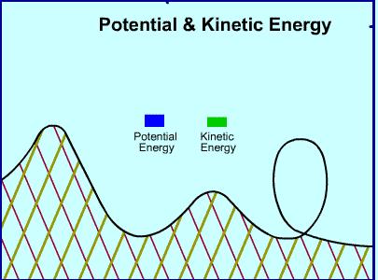

Slide 16
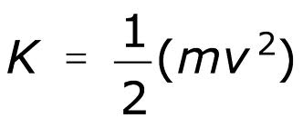
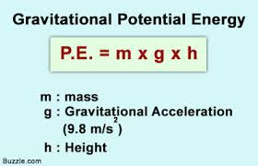
Calculating Energy
Kinetic Energy =
Potential Energy = weight x height
Weight = Newtons
Height = Meters

Slide 17
Practice Problems
You serve a volleyball with a mass of 2 kg. The ball leaves your hand with a speed of 30 m/s. The ball has ______________________ energy. Calculate it.

Slide 18
Practice Problems
A car is traveling with a velocity of 20 m/s and has a mass of 100 kg. The car has ___________energy.
Calculate it.

Slide 19
Practice Problems
A skier is traveling down the mountain with a velocity of 50 m/s and has a mass of 100 kg. The skier has ___________________ energy. Calculate it.

Slide 20
Practice Problems
A baby carriage is sitting at the top of a hill that is 20 m high. The carriage with the baby weighs 5 N. The carriage has ____________ energy.
Calculate it.

Slide 21
Practice Problems
A roller coaster is at the top of a 72 m hill and weighs 1050 N. The coaster (at this moment) has ____________ energy. Calculate it.

Slide 22
Movie Notes
Write the following questions in your notes and you’ll answer them while watching the movie:
1. Define energy
2. Compare and Contrast POTENTIAL and KINETIC energy
3. What does the Law of Conservation of energy say?
4. What are some examples of Renewable Energy and what are the benefits?

Slide 23
Warm-Up Feb. 3, 2014
1. Sort the following as a physical change or chemical change in a T chart:
*crushed rock * digested food * soured milk
*rusted metal *molding clay *melting a popsicle
*sanding wood
2. How can a compound be broken down?
A. by physical changes B. by chemical changes
3. When two or more elements join together chemically
A. A compound B. a mixture C. a substance that is the same as the elements is formed

Slide 24
Warm-Up Feb. 4, 2014
Write the question and answer
1. To calculate acceleration, you need to know
A. distance traveled and speed
B. starting point, end point, and mass
C. starting velocity, final velocity, and time it takes V to change
D. average speed and time
2. To produce change in motion, a force must be a(n)
A. balanced force B. unbalanced force
C. frictional force D. gravitational force
3. What causes machines not to be 100% efficient?

Slide 25
Warm-Up Feb. 6, 2014
Look in your notes:
1. What is the difference between kinetic and potential energy?
2. What is the equation for kinetic energy?
3. You serve a volleyball with a mass of 5 kg. The ball leaves your hand with a speed of 30 m/s. What is it’s KE?

Slide 27
Warm-Up Feb. 6, 2014
Calculate the potential and kinetic energy on your worksheet!
SET YOUR HOMEWORK OUT ON YOUR DESK TO BE CHECKED!!!

Slide 28
1. You serve a volleyball with a mass of 2.1 kg. The ball leaves your hand with a speed of 30 m/s. The ball has ______________________ energy. Calculate it.

Slide 29
2. A baby carriage is sitting at the top of a hill that is 21 m high. The carriage with the baby weighs 12 N. The carriage has ____________ energy. Calculate it.

Slide 30
3. A car is traveling with a velocity of 40 m/s and has a mass of 1120 kg. The car has ___________energy. Calculate it.

Slide 31
4. A cinder block is sitting on a platform 20 m high. It weighs 79 N. The block has _____________ energy. Calculate it.

Slide 32
5. There is a bell at the top of a tower that is 45 m high. The bell weighs 190 N. The bell has ____________ energy. Calculate it.

Slide 33
6. A roller coaster is at the top of a 72 m hill and weighs 966 N. The coaster (at this moment) has ____________ energy. Calculate it.

Slide 34
7. What is the kinetic energy of a 3-kilogram ball that is rolling at 2 meters per second?

Slide 35
8. Two objects were lifted by a machine. One object had a mass of 2 kilograms, and was lifted at a speed of 2 m/sec. The other had a mass of 4 kilograms and was lifted at a rate of 3 m/sec.
a. Which object had more kinetic energy while it was being lifted?
b. Which object had more potential energy when it was lifted to a distance of 10 meters? Show your calculation.

Slide 36
Use the reading pages to fill in the chart!!!

Slide 37
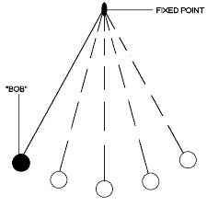
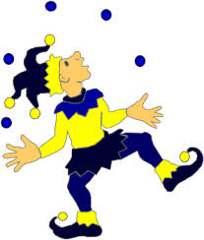
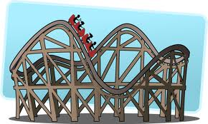
Mechanical Energy
Total Energy of motion and position
Examples: Roller Coaster, Car, Pendulum
Both: Potential and Kinetic

Slide 38
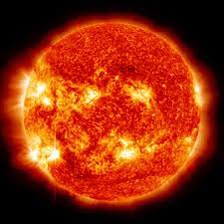
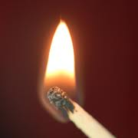
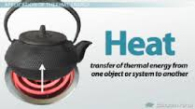
Thermal Energy (Heat)
All the kinetic energy due to the random motion of particles
Examples: Sun, light, heat from a toaster
Kinetic!

Slide 39
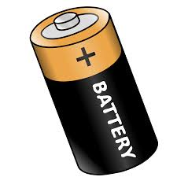
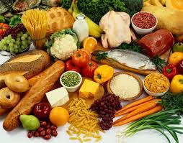
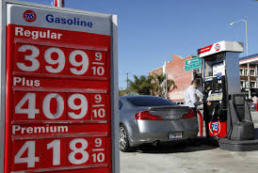
Chemical Energy
Energy stored in chemical bonds that hold compounds together
Examples: Food, Batteries, Gas
Potential Energy

Slide 40
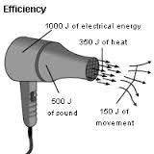
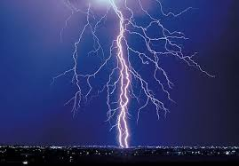
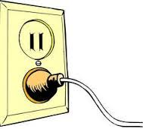
Electrical Energy
Energy of moving particles like electrons
Outlets, anything with a cord, toaster
Potential and Kinetic

Slide 41
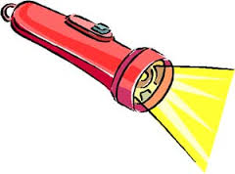
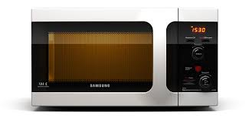
Light Energy
Vibrations of electrically charged particles
Microwaves, light bulb, flashlight
Kinetic

Slide 42
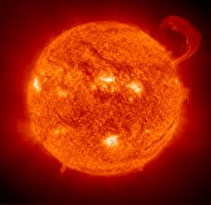
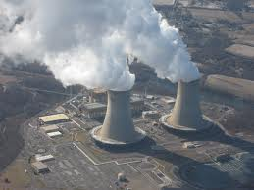
Nuclear Energy
Energy stored in the nucleus of an atom
Sun, Nuclear power plants
Potential Energy

Slide 43
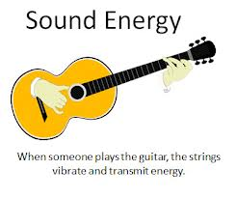
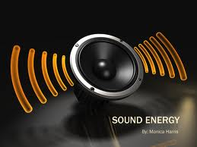
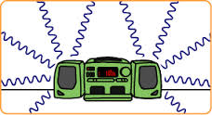
Sound Energy
Energy from vibrating object
Examples: Guitar strings, voice
Both potential and kinetic energy

Slide 44
Warm-Up Feb. 7, 2014
Write the question and answer
1. What is an energy transformation?
2. What types of energy are transferred using a toaster?
3. What forms of energy do you see in a waterfall?

